Slide 1
The flow of data, information and knowledge within the health system
Bob Marshall, MD MPH MISM FAAFP
DoD Clinical Informatics Fellowship

Slide 2
Learning Objectives
Basic definitions of knowledge
Health-related knowledge
Sources and types of data
Data to information to knowledge
Knowledge audiences
Knowledge examples

Slide 3
Definitions – 1 of 3
Data –
factual information (as measurements or statistics) used as a basis for reasoning, discussion, or calculation
information output by a sensing device or organ that includes both useful and irrelevant or redundant information and must be processed to be meaningful
information in numerical form that can be digitally transmitted or processed

Slide 4
Definitions – 2 of 3
Information –
knowledge that you get about someone or something: facts or details about a subject
knowledge communicated or received concerning a particular fact or circumstance
knowledge gained through study, communication, research, instruction, etc.; factual data

Slide 5
Definitions – 3 of 3
Knowledge
acquaintance with facts, truths, or principles, as from study or investigation; general erudition
familiarity or conversance, as with a particular subject of branch of learning
acquaintance or familiarity gained by sight, experience, or report
the fact or state of knowing; the perception of fact or truth

Slide 6
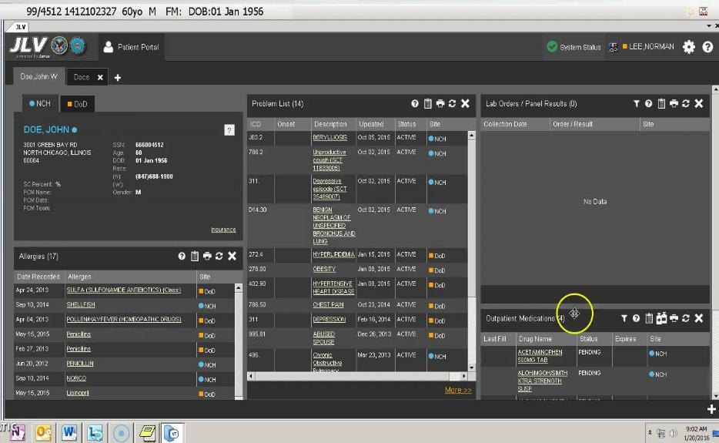

Slide 7
Definitions – Health-Related
Health Data - data related to health care, health conditions, reproductive outcomes, causes of death and quality of life
Information - information regarding health and health care – contains all of the above
Knowledge - internalization and application of the health data/health information to help make better decisions and improve health outcomes

Slide 8
Sources of Health Data
Patients and healthcare team via the EHR
Monitors – both outpatient and inpatient
Scanned documents
Administrative data
IoT devices
Cameras – video and still
Mobile devices – wearables and other
PACS; EKG software; other EHR’s

Slide 9
Discrete and Non-discrete Data
Unchanged over time
Still sits at 30% discrete and 70% non-discrete
Much harder to turn non-discrete data into information or knowledge
NLP and key word searching can turn non-discrete data into discrete data for analysis → information and knowledge

Slide 10
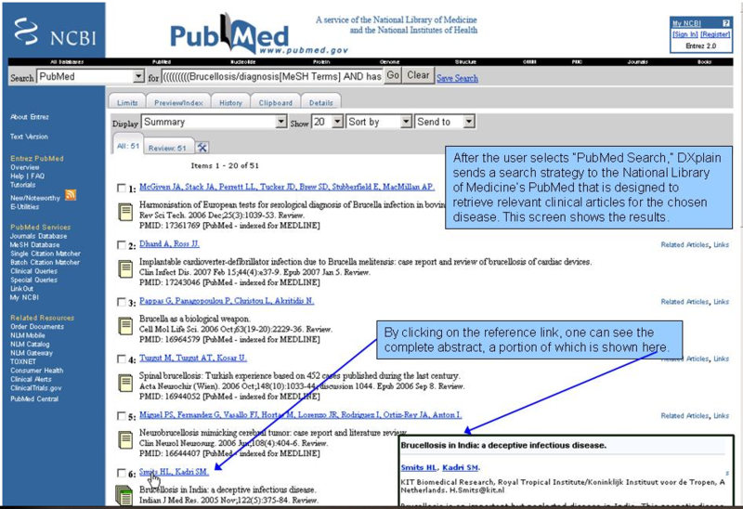

Slide 11
Data Flow
EHR data flows directly into the EHR database
Other sources of data can send data to the EHR database, but it is often stored as an XML or PDF file
When viewed, are either viewed as image files, HTML files or PDF image files
Often require an add-on viewer/document manager to see them (HAIMS, ChartMaxx, JLV, OnBase, 3M, etc)

Slide 12
Data to Information
Data has to be analyzed to create information
Data can be analyzed as pure statistics, it can be analyzed as trends or it can be analyzed as comparisons
Information can then be presented back to the end users so they can act on it, either at the point of care or in retrospect
Information still has to be processed by the end user or another application to apply it as knowledge

Slide 13
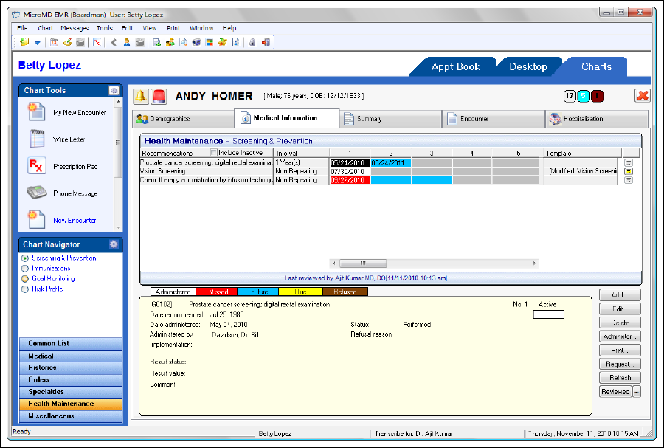

Slide 14
Information to Knowledge
Information still needs additional processing to turn it into knowledge (despite the previous definitions)
That additional processing either occurs in the end user’s brain or by way of additional software that combines information with context (both current and historical)
This is what is commonly referred to as advanced clinical decision support – when the EHR becomes a partner
For now, the only way this occurs is internally, as part of evidence-based guidelines or similar publications

Slide 16
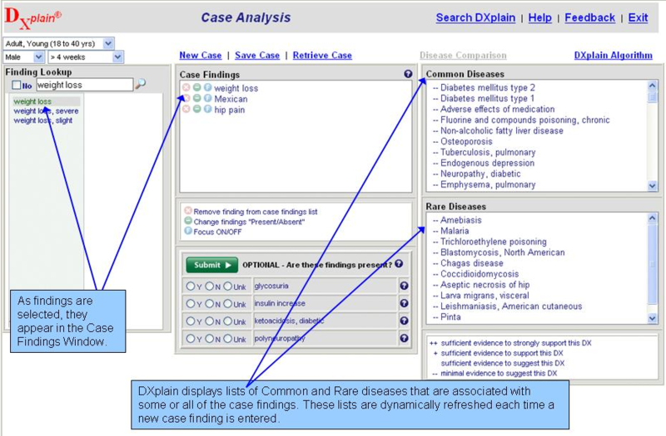

Slide 17
Various Audiences for Flow
Healthcare team
Patients
Administrators
Payers
Government

Slide 18
Healthcare Team

Slide 19
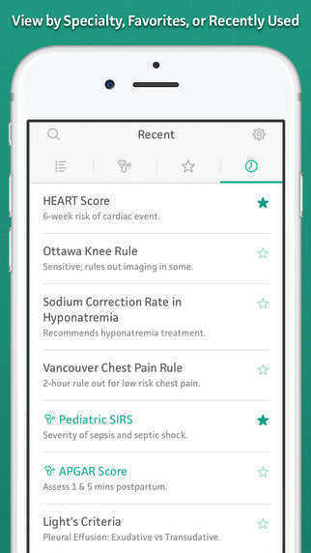
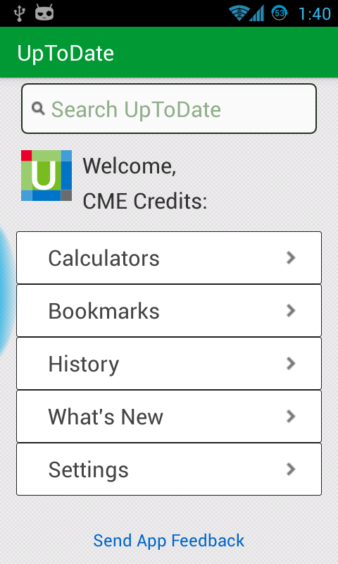

Slide 20
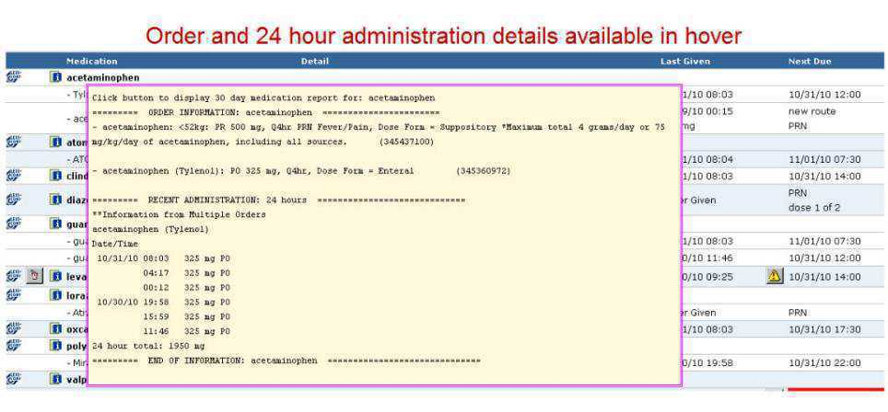

Slide 21
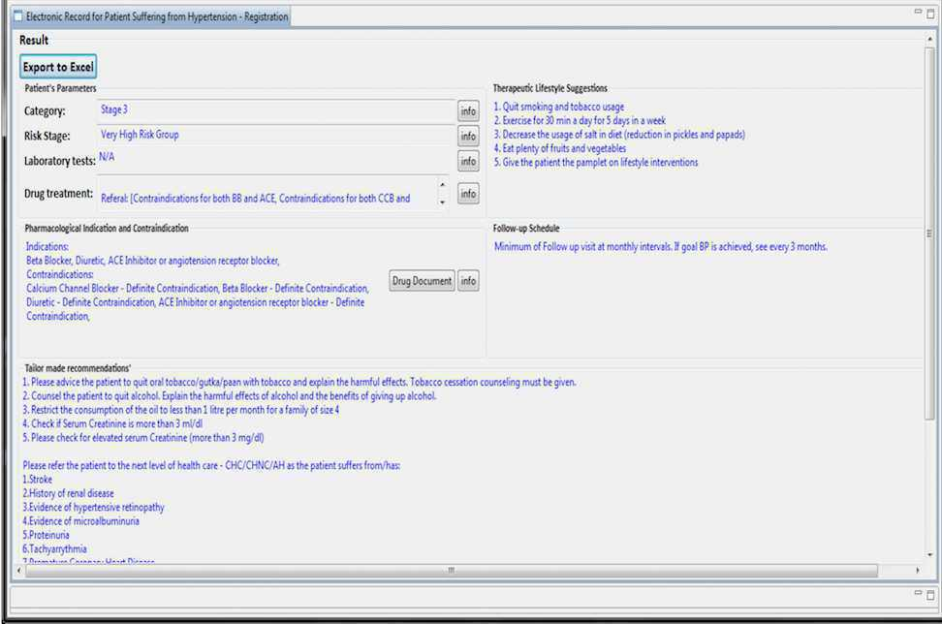

Slide 22
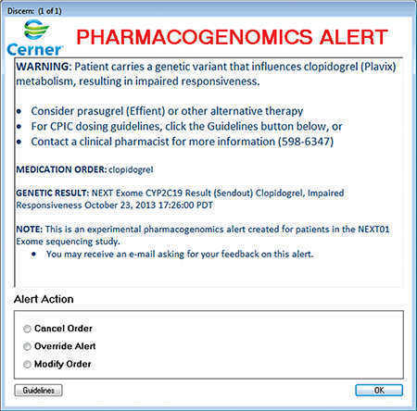

Slide 23
Patients

Slide 24
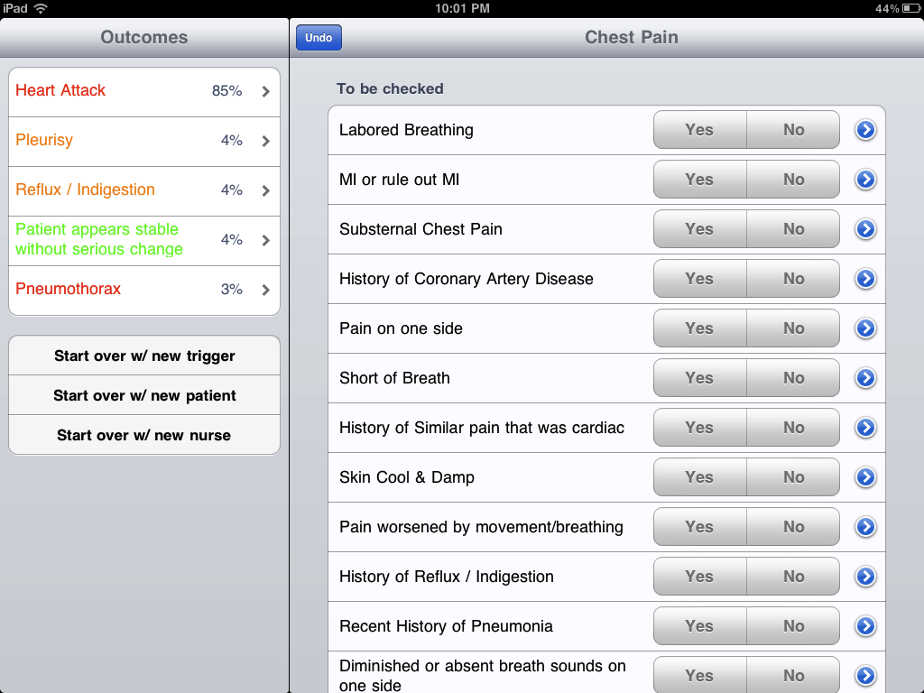

Slide 25
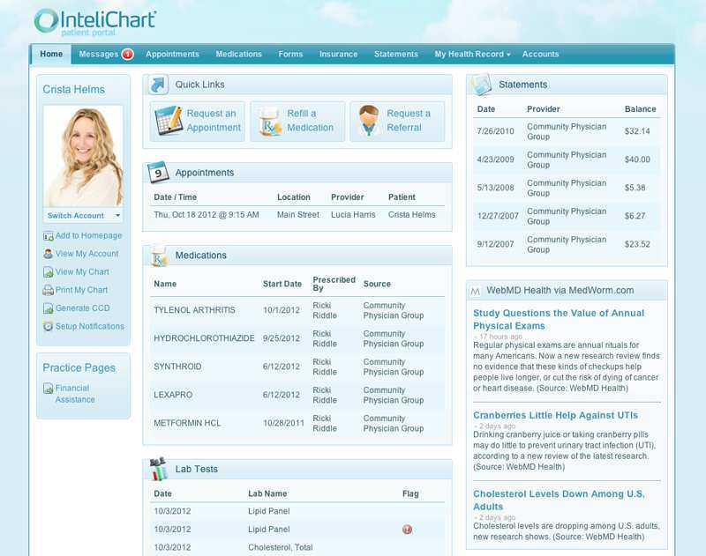

Slide 26
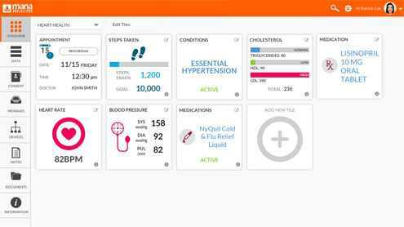

Slide 27
Administrators

Slide 28
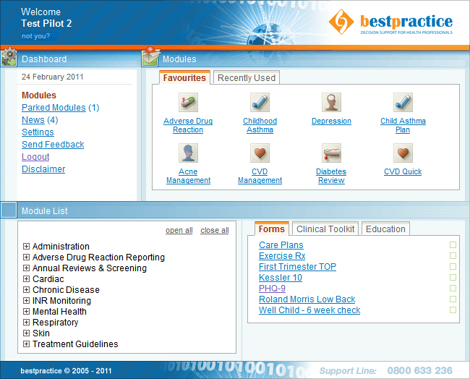

Slide 29
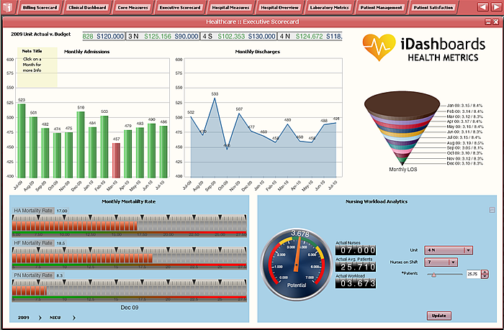

Slide 30
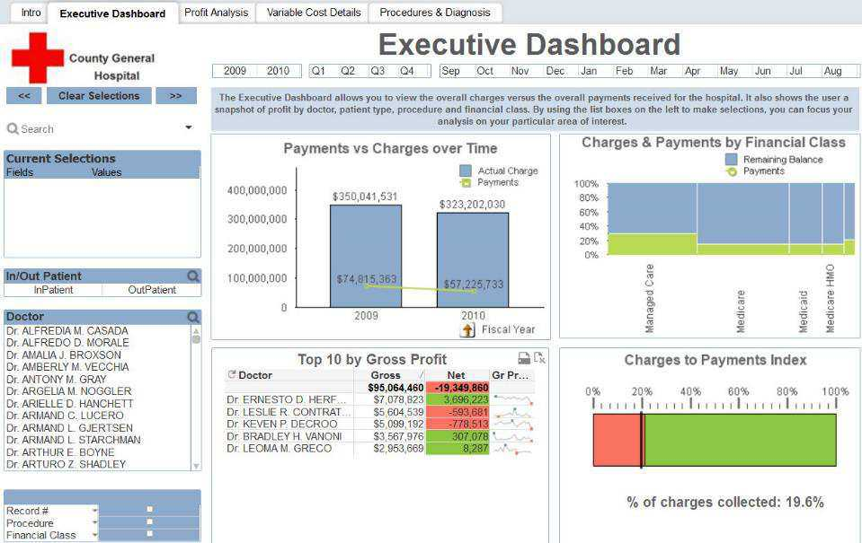

Slide 31
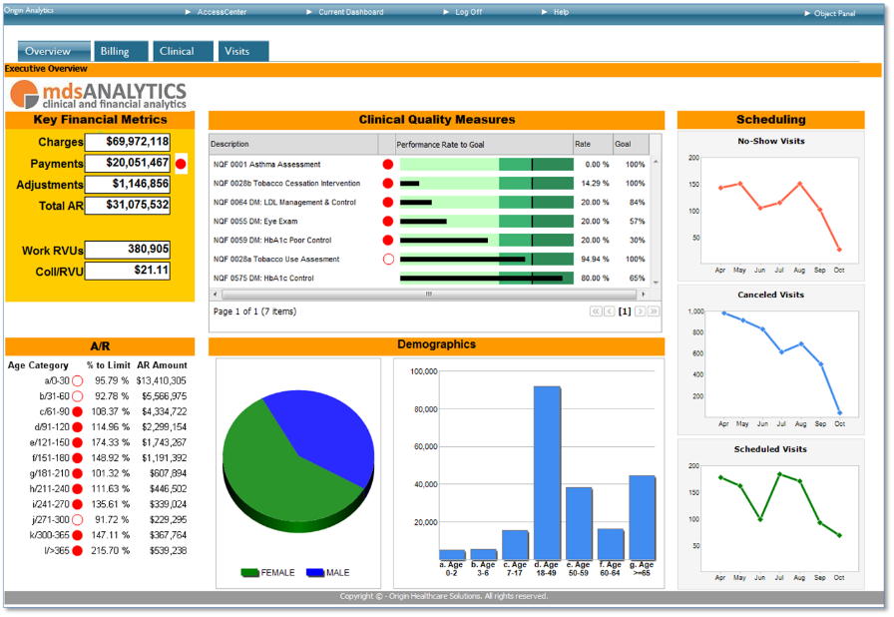

Slide 32
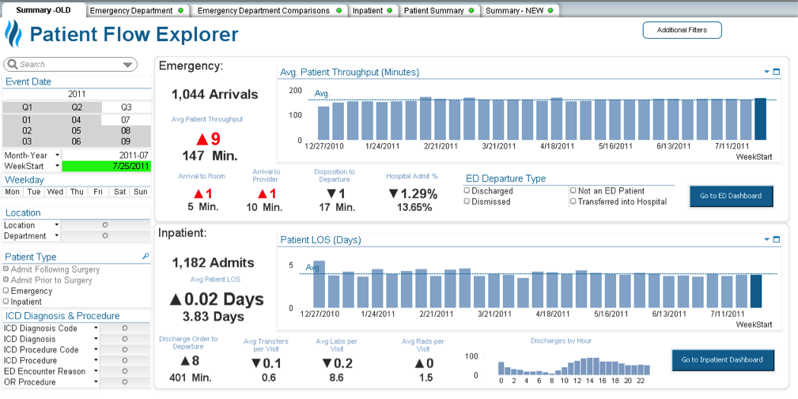

Slide 33
Payers/Government

Slide 34
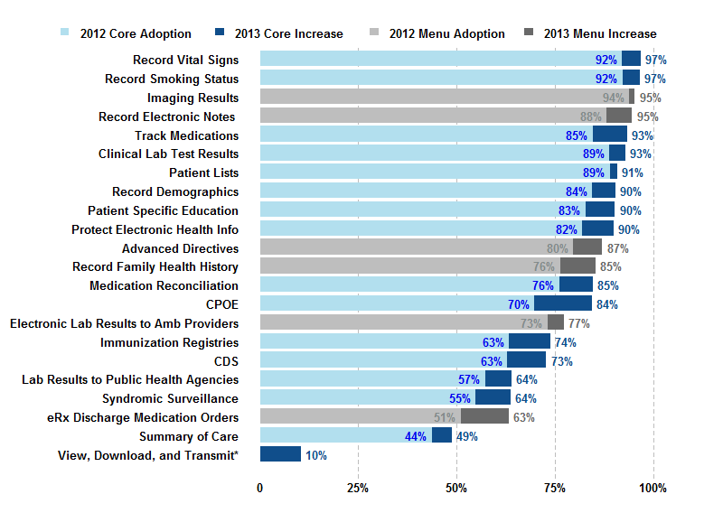

Slide 35
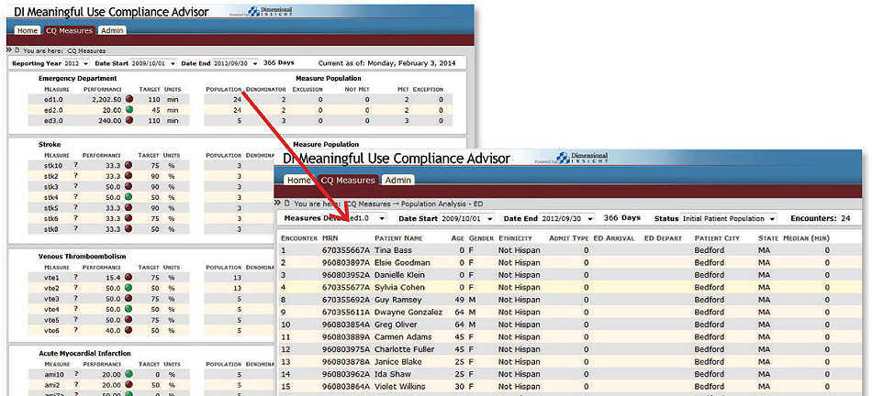

Slide 36
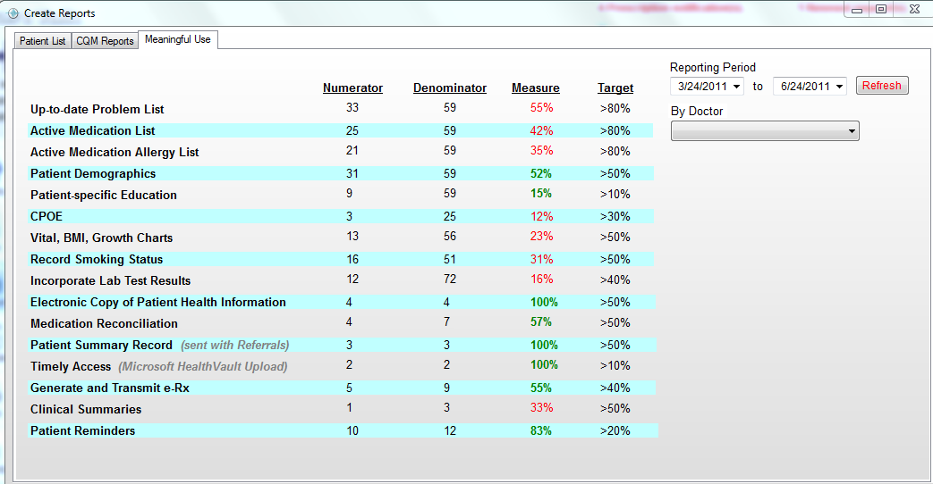

Slide 37
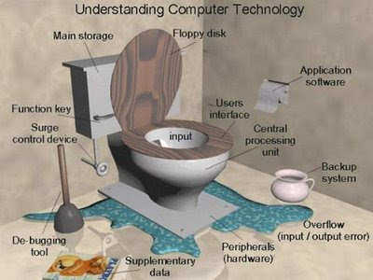
Questions

